Slide 1

Confluence API
Migrating from Cards to Tabs
August 2023

Slide 2
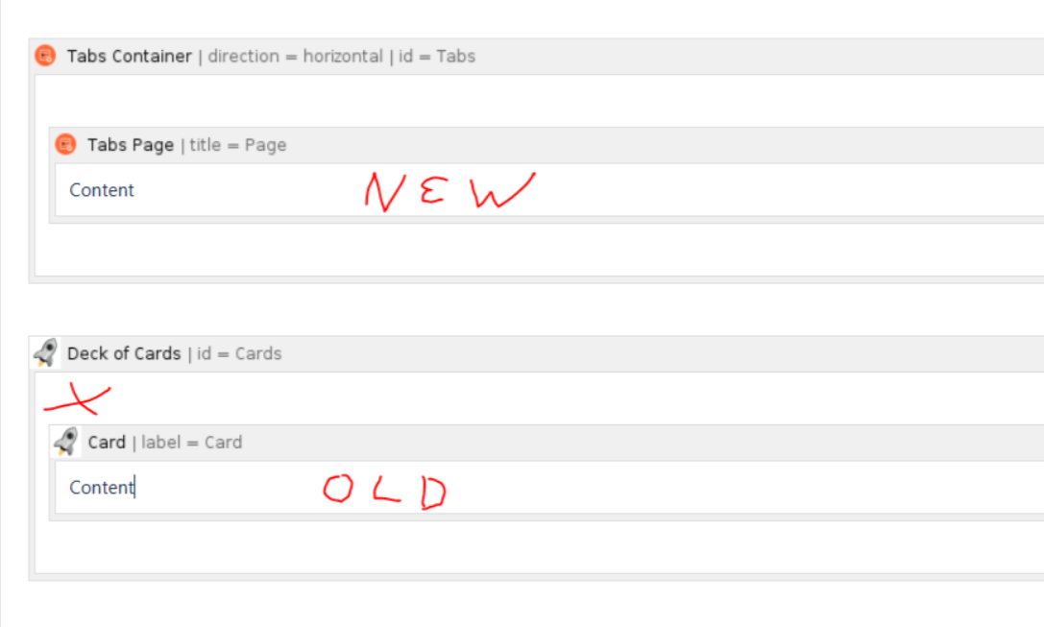
Task
Atlassalon
Migrating ~ 1,100 TEAM pages from the Deck of Cards / Cards macro to the Tabs Container / Tabs Page macro combo.

Slide 3
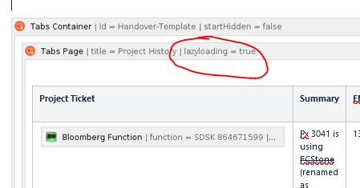
Atlassalon
Reason
Our ‘Solution Architect Database’ page had become very slow. It uses the Page Properties Report macro, which collates information from pages containing the Page Properties macro.
How could we achieve better performance? By minimizing the information the report macro must process. The lazy loading feature of the Tabs macro achieves that by not requesting content from the database unless somebody is looking at the tab in question.
Furthermore:
Cards macro is labeled as deprecated by developers
Tabs macro allows more reliable linking to specific tabs

Slide 4
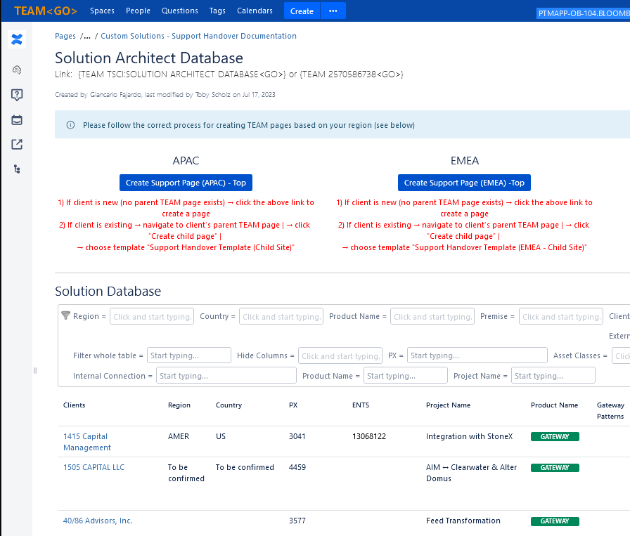
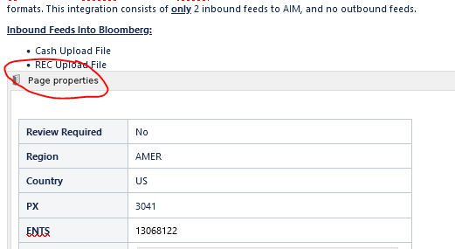
Atlassalon
The SA Database is generated using the Page Properties Report macro. This in turn loads each page in a defined space, and extracts data from the Page Properties macro.

Slide 5
Atlassalon
Approach
Using BQNT as reasonable network access on Corp Using Confluence Python API as a wrapper around the REST calls
Challenges
Nested Tabs Pages cannot have lazy loading applied. Hence, need to process XML, not just string replacement
Confluence Storage format is not ‘valid’ XML
Confluence storage format should not end up as valid XML → Settled on Beautiful Soup
Some (other) macros are incompatible with lazy loading
BS4 breaks when page contains nested XML (only two pages affected)

Slide 6
Atlassalon
Solution
Stats via REST API call:
Average load time
Before (using Cards macro): 13.57 seconds
After (Using Tabs macro): 3.78 seconds
→ ~ 72% improvement (experience differs in web browser)
Script and performance stats on {BBGH tscholz4/confluence_cards_tabs_migration <GO>}

Slide 7
Atlassalon
Issues
Tabs don’t load after session expired (reload page)
Still significant delay from ‘Table Filter’ plugin (~ 12 seconds), DRQS 172528103 is open

Slide 8
Atlassalon
Wot?! Where is the REST?
I expected to see REST calls, where are they?!
A live exploration

Slide 9
Atlassalon
? Questions ~ Answers (maybe) !

Slide 10
Atlassalon
THANK YOU
Toby Scholz | tscholz4@bloomberg.net | {BBUR TOBY <GO>}

